Slide 1
It’s Time to Recycle!
Javier Fuentes
Students, Teachers, And Resources in the Sciences (STARS)
University of South Florida
April 5, 2010

Slide 2
What does it mean to “Recycle” our bottles, cans, and paper?
It means…
you don’t throw them away
with the garbage; but instead,
you send your bottles, cans and paper to a place that uses them to make new products.
2

Slide 3
Recycling begins with you.
3

Slide 4
Garbage collectors pick up your recyclables including bottles, cans and paper.
4

Slide 5
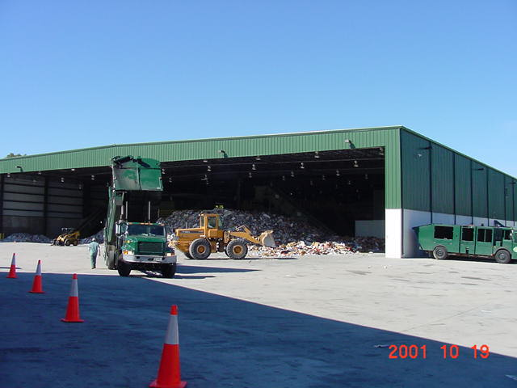
The recyclables are taken to a
Material Recovery Facility to be sorted.
5

Slide 6
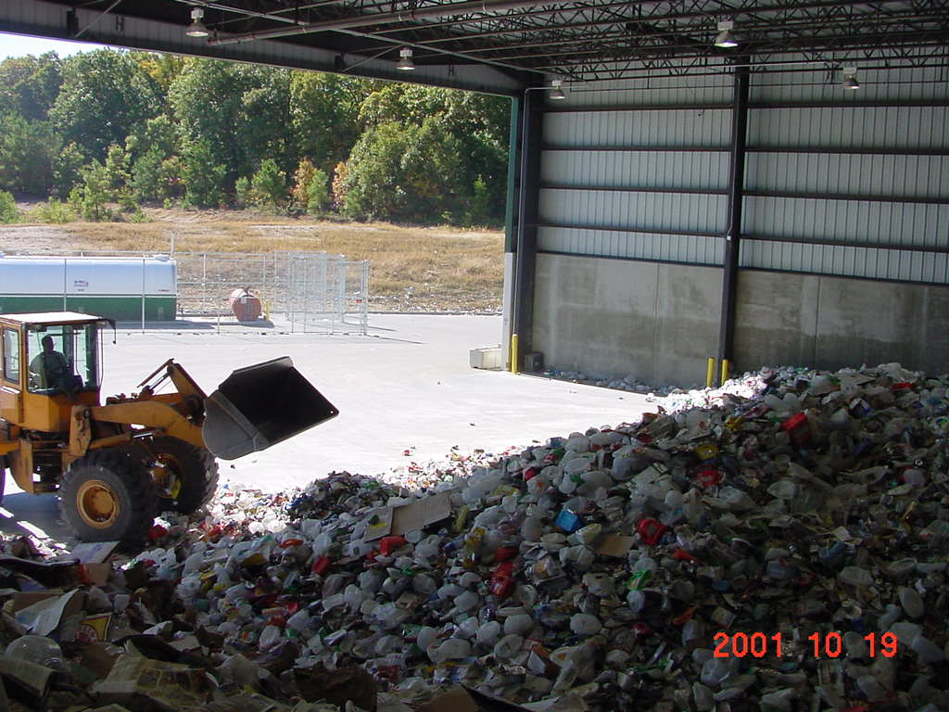
The recyclables are pushed into a pile inside the building.
6

Slide 7
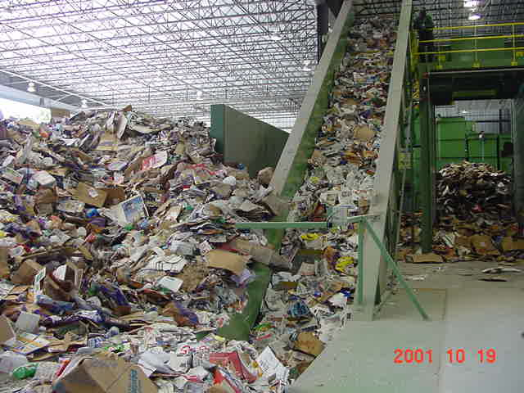
Recyclables are carried by conveyor.
7

Slide 8
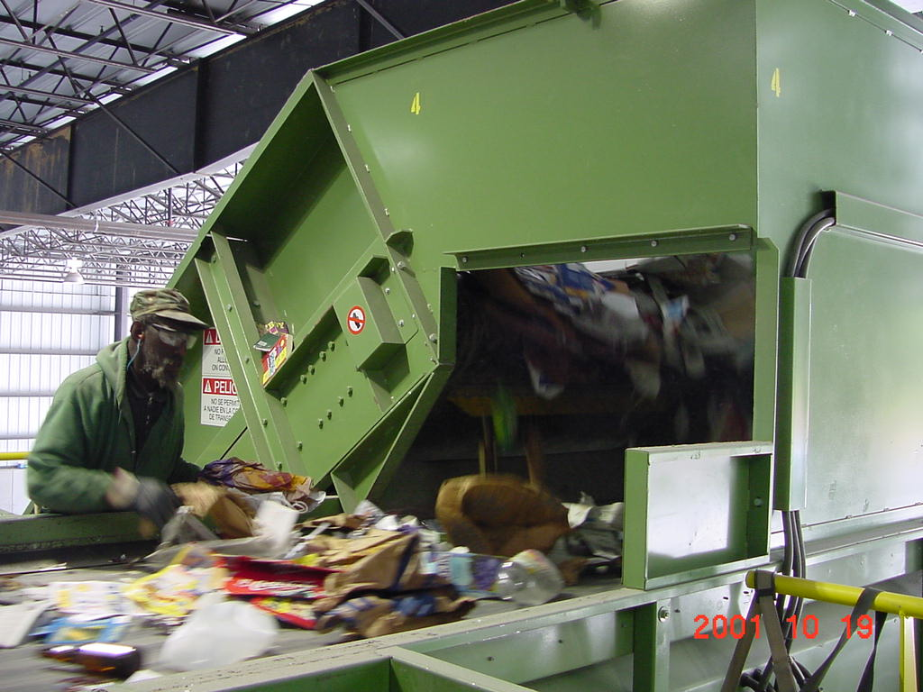
Workers begin to sort the recyclables.
8

Slide 9
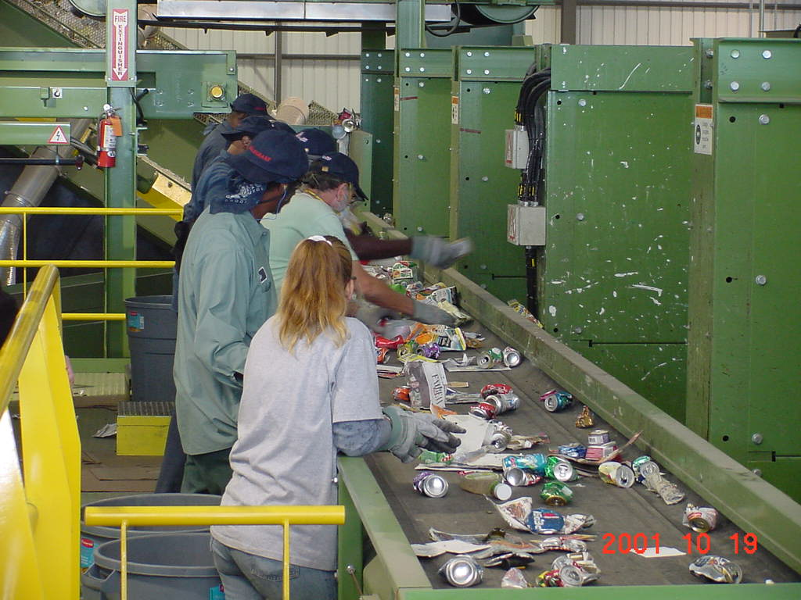
More workers sort the recyclables.
9

Slide 10
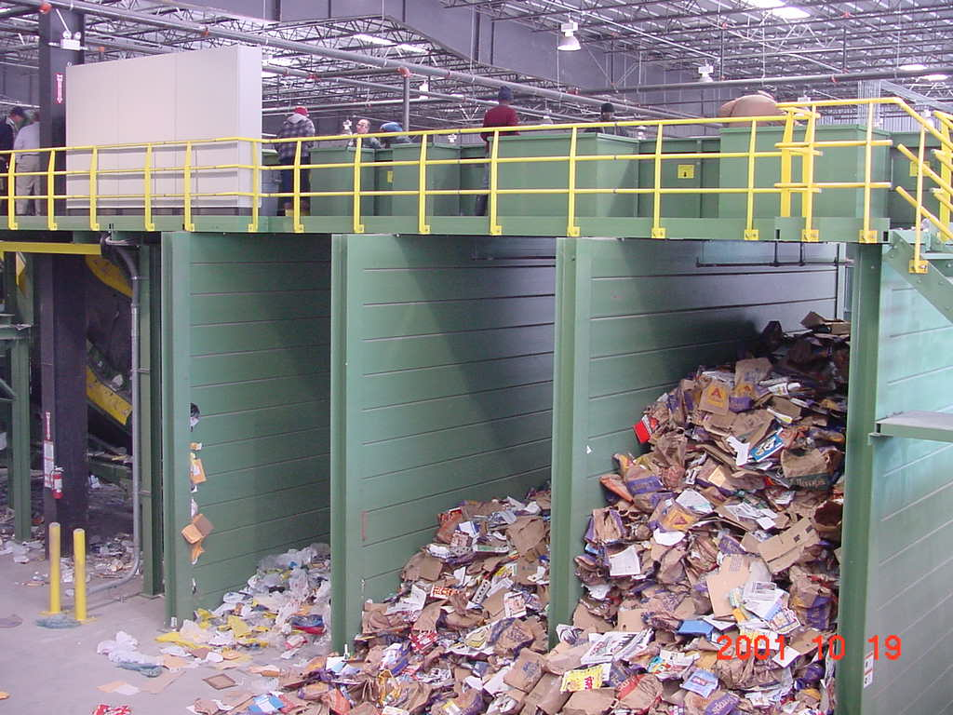
Some of the items are dropped into large bins.
10

Slide 11
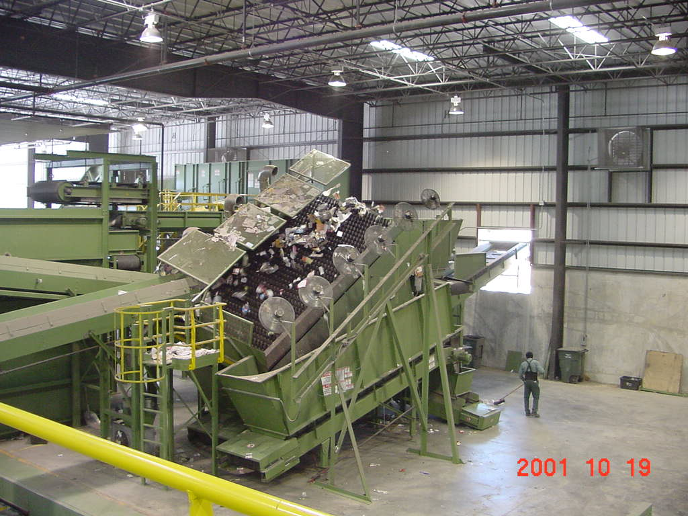
Fans blow the recyclables to separate the lighter items from the heavier items.
11

Slide 12
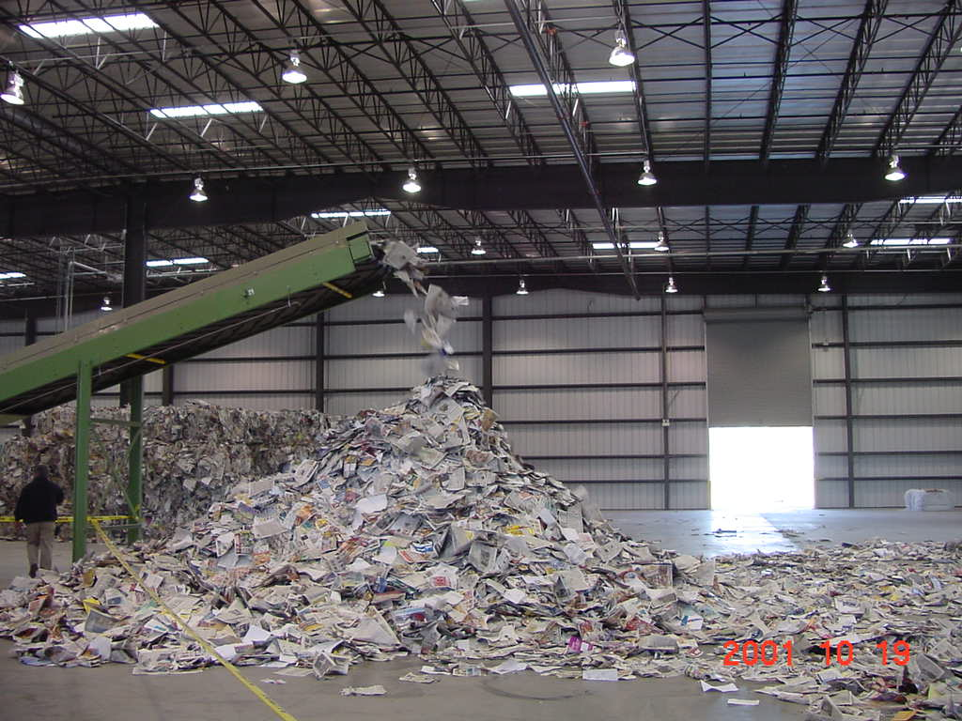
Newspaper falls from the conveyor.
12

Slide 13
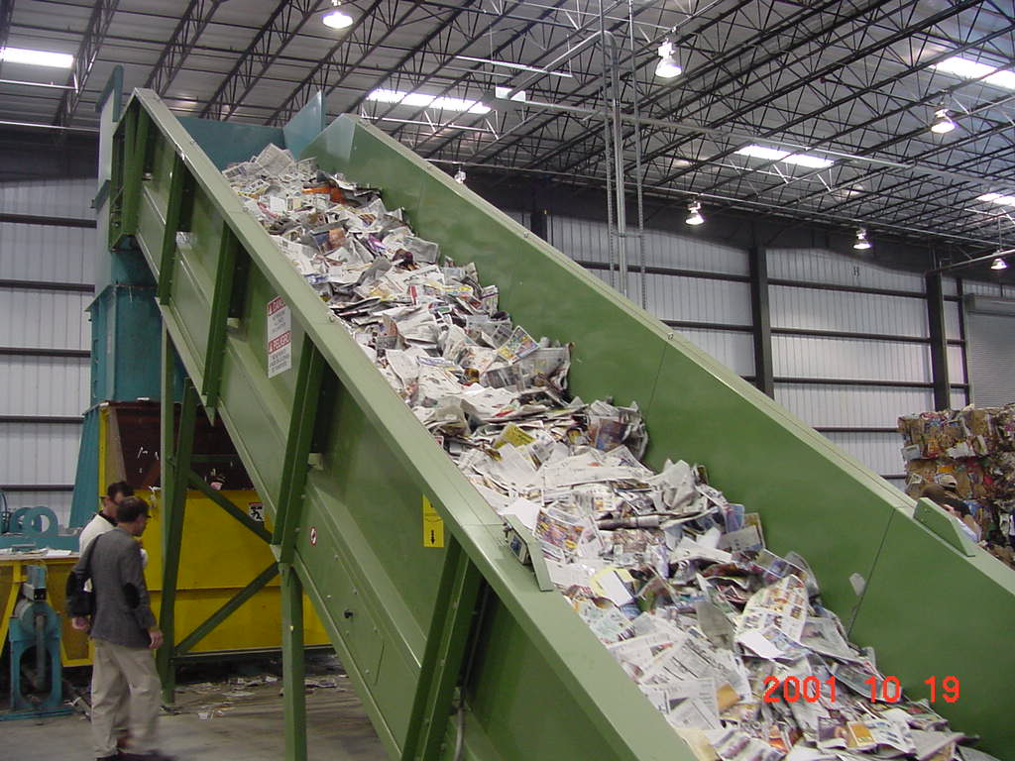
Newspaper is carried to the baler.
13

Slide 14
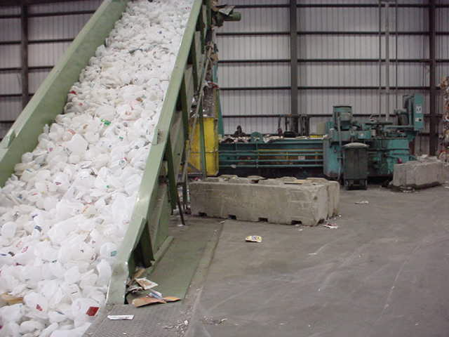
Milk jugs are carried to the baler.
14

Slide 15
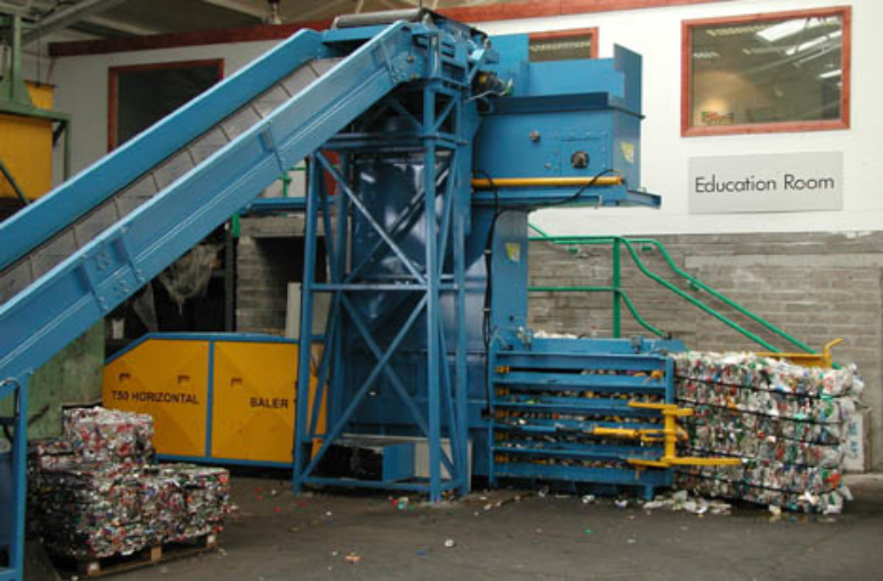
Recyclables in the baler.
15

Slide 16
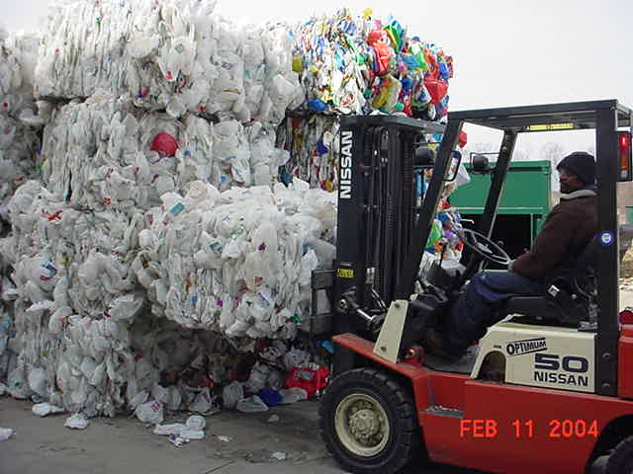
A forklift is used to stack the bales.
16

Slide 17
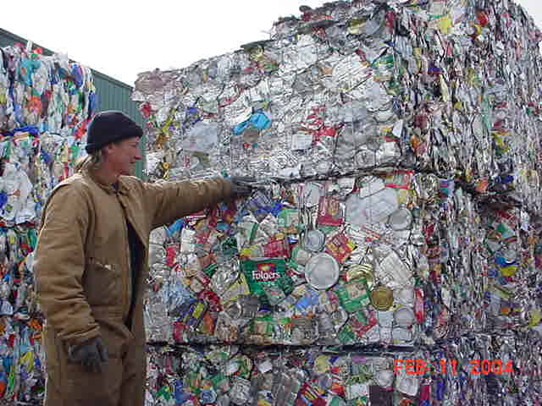
Stacked bales of steel cans.
17

Slide 18
The sorted recyclables are sold to manufacturers.
18

Slide 19
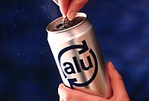
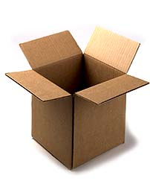

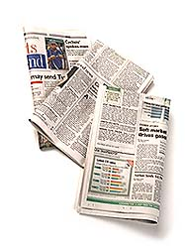
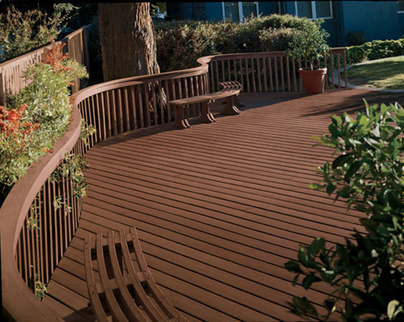
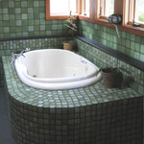
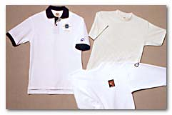
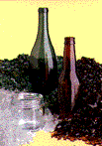
Manufacturers make new products from the recyclable bottles, cans and paper.
19

Slide 20
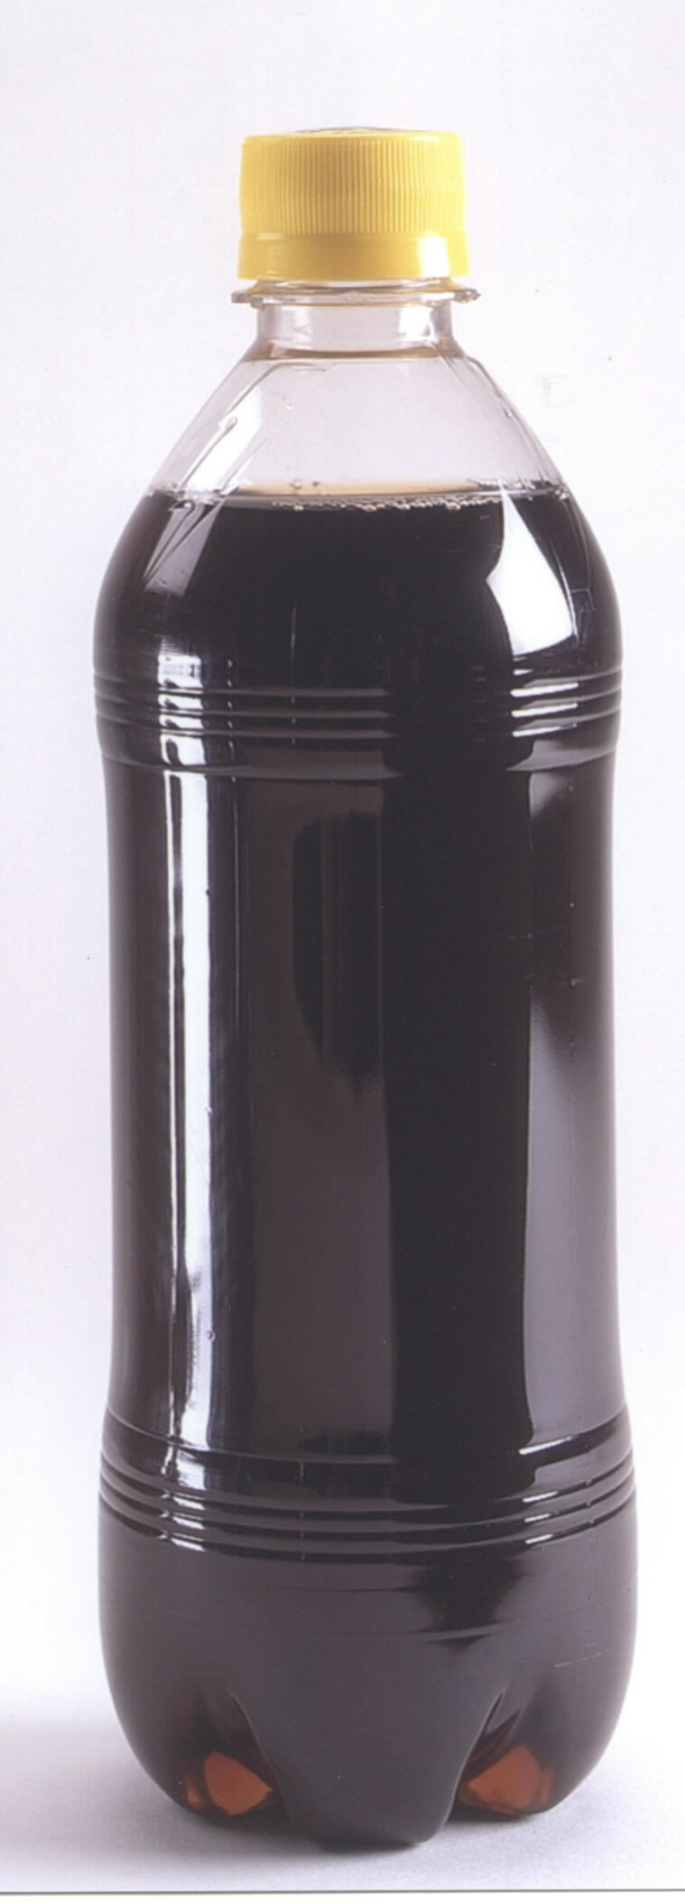
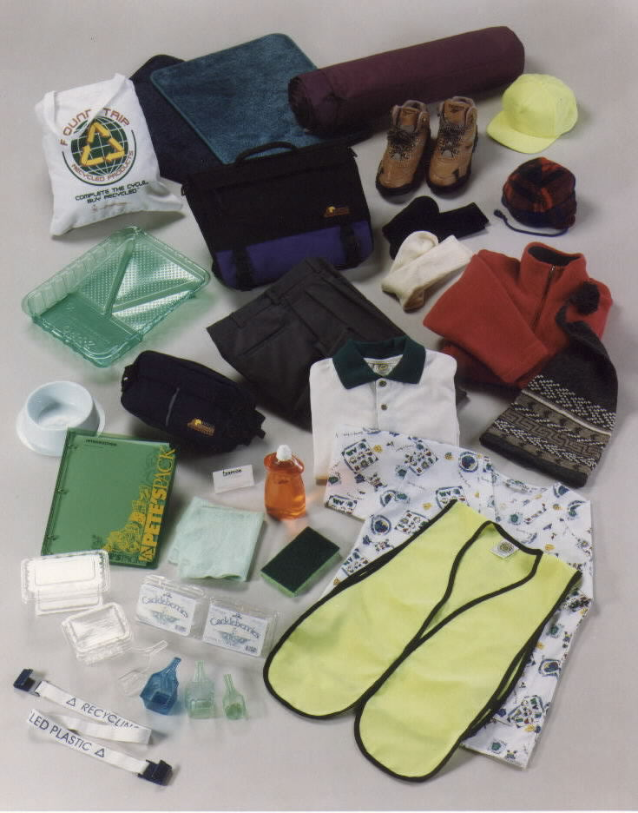
20

Slide 21
Manufacturers sell the new recycled products to stores.
21

Slide 22
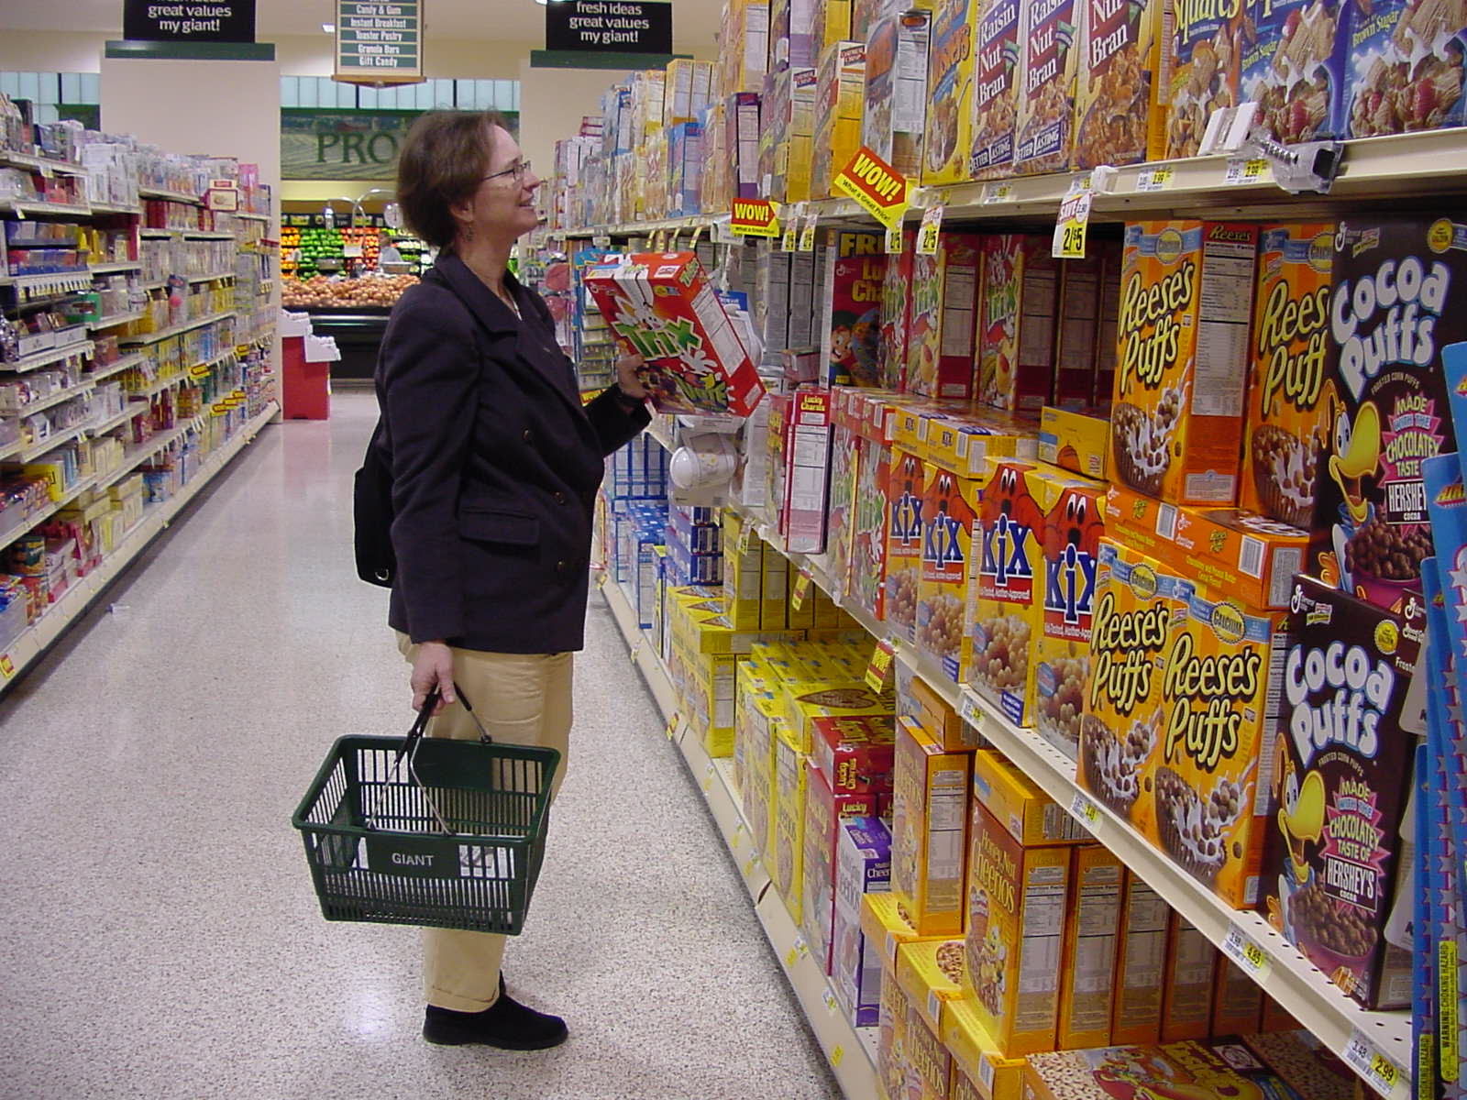
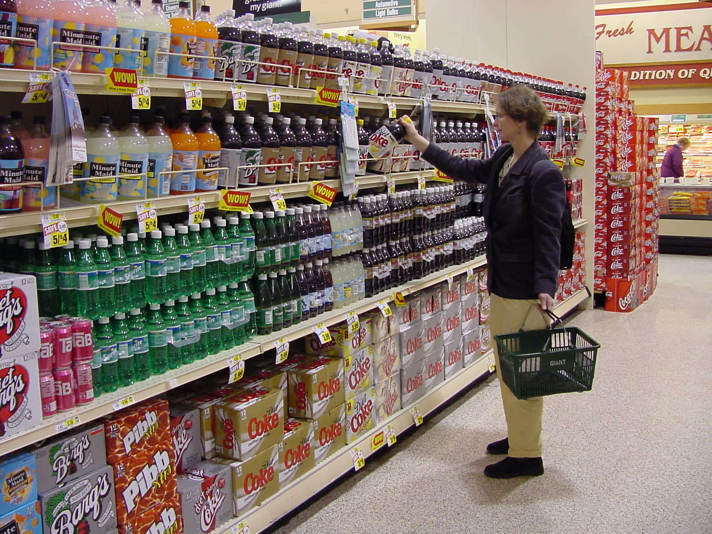
We buy the new products at the store.
22

Slide 23
The Recycling Symbol
means
means
The product or packaging
is recyclable
The product or packaging is
made from recycled material
23

Slide 24
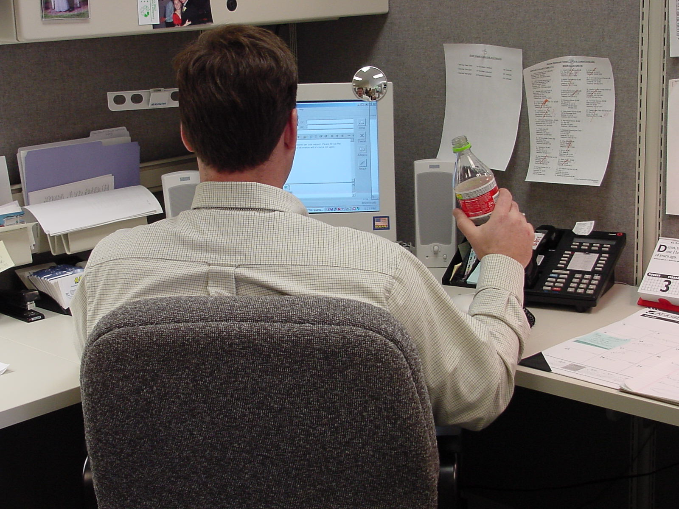
We use the things we buy, and then we...
24

Slide 25
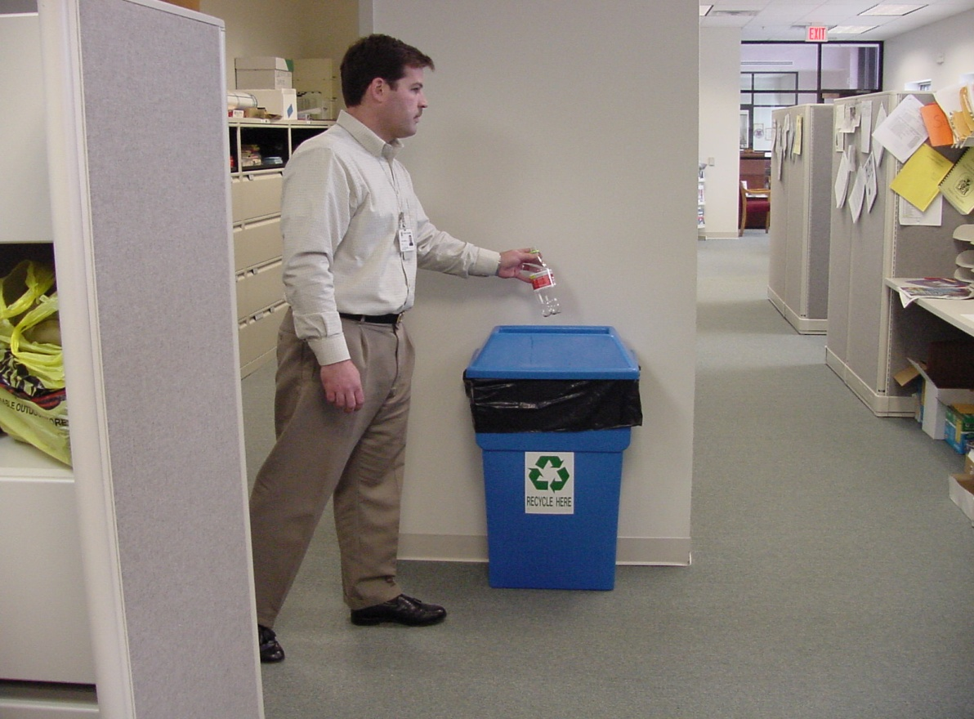
Recycle again!
25

Slide 26
So why should you recycle?
26

Slide 27
Recycling helps conserve natural resources.
Natural resources are…
  Water
  Land
  Forests
  Minerals
  Fossil fuels
27

Slide 28

Aluminum cans may be recycled back into new aluminum cans.
28

Slide 29
If we don’t recycle aluminum cans, we must dig minerals from the earth to make new aluminum cans.
29

Slide 30
Recycling helps prevent the loss of wildlife habitat.
30

Slide 31
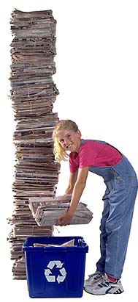
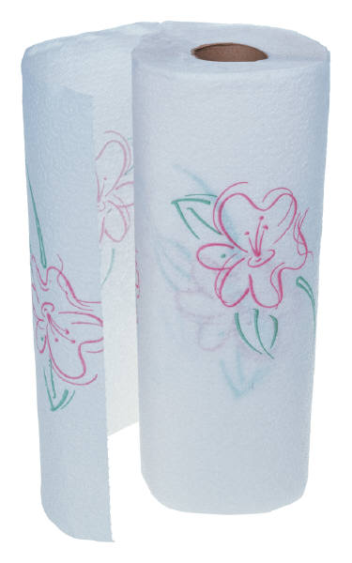
We can recycle paper to make new paper.
31

Slide 32
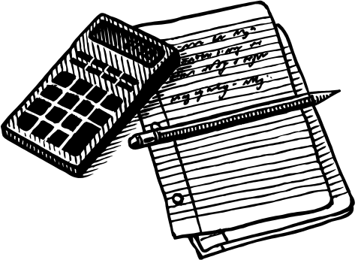
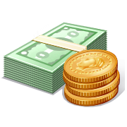

Paper Facts
Paper is used in the US:
  to print 23 billion newspapers,
  Billions of books, &
  340 million magazines.
Where do you use paper?
  Packaging
  Notebook paper
  Paper money
  Toilet Paper!
32

Slide 33
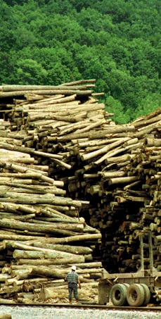
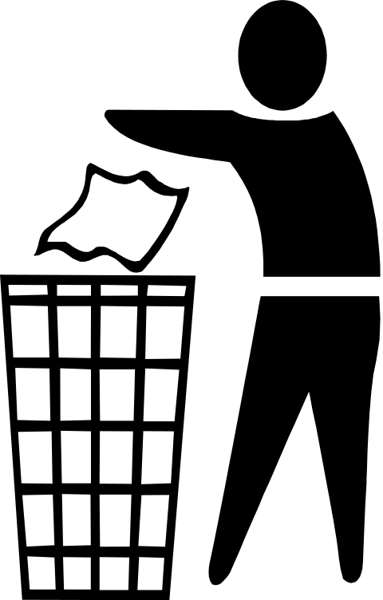
If we don’t recycle paper, more trees must be used to make new paper.
Trees provide habitat for animals.
TRASH
33

Slide 34
Recycling helps protect our environment.
How?
  Recycling prevents pollution.
34

Slide 35
The End!

